Slide 1
Developing a Calculator for the Phase Fraction and Uncertainty of Austenite in Steel
Caleb Schenck & Max Garman
Date: March 15, 2022
Advisors: Dr. Adam Creuziger*, David Newton* (MS) & Dr. Kip Findley
Affiliations:
*National Institute of Standards and Technology (NIST)
Sheet and Coated Steels

Slide 2
Undergraduate Research
Date Initiated: September 2021
Anticipated Completion Date: August 2022
Acknowledgments:
* Brian Toby & Robert Von Dreele – GSAS II
* Melissa Thrun – Austenite Stability Equations
* Michael Cox – Texture effects of phase fraction measurement
* Dream3D software
Notes:
Project Status
Use greater then 20 point Arial font

Slide 3
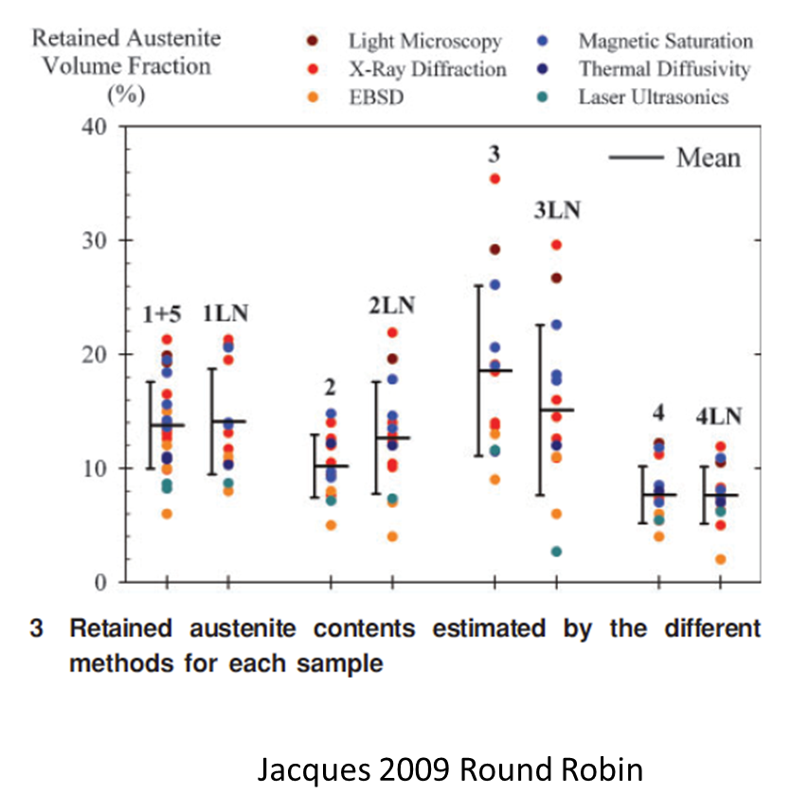
Relevance
In both industry and research, the uncertainty and/or error of measuring phase fractions is commonly overlooked.
In the case of measuring retained austenite, this is especially disagreeable.
Notes:
Industrial Relevance
Include a clear statement of industrial relevance
Use greater then 20 point Arial font

Slide 4
Project Plan
Project Objective:
- To develop a web-based austenite calculator with uncertainty.
Expected Product:
XRD Data
Uncertainty
Instrument Parameters
Phase Fractions
Calculator
Material Structure
Guidance
Notes:
Project Plan
Working Hypothesis or Project Objective: (Insert a clear statement that identifies the hypothesis, that clarifies why you are doing what you are doing.)
Expected Results: (a succinct statement of your expected results – presented in a manner to assist sponsors in assessing how they should plan to use your results.)
Project Scope: (a clear statement of the scope of your program that clarifies what you are doing and how you are doing it – if necessary the scope could be on a separate page)
Use greater then 20 point Arial font

Slide 5
Project Plan Cont.
Project Scope:
Coding
Done in python, leveraging the GSAS II library
Material Characteristics
Microstructure, texture, x-ray interactions, composition, lattice parameters, etc.
Defining Uncertainties
Finding ways to model the various uncertainties via statistical analysis (very difficult)

Slide 6
Sources of Uncertainty or Error
Diffraction Counting Statistics
Deviation between theoretical intensities and measured intensities
Composition
Method of calculation
Unit cell determination
Sampling volume and crystallites illuminated
Pole figure coverage and crystallographic texture effects
Number of replicate measurements or samples
*Black – present *Blue – Next *Teal – Future

Slide 7
Inputs
XRD data
Intensity vs 2θ data collected via powder x-ray diffraction methods and tools
Instrument Parameters
X-ray system configuration, source material, filters, scan type, etc.
Material Structure
CIF file: crystallographic information, and elemental composition
Microstructure information: texture and grain size

Slide 8
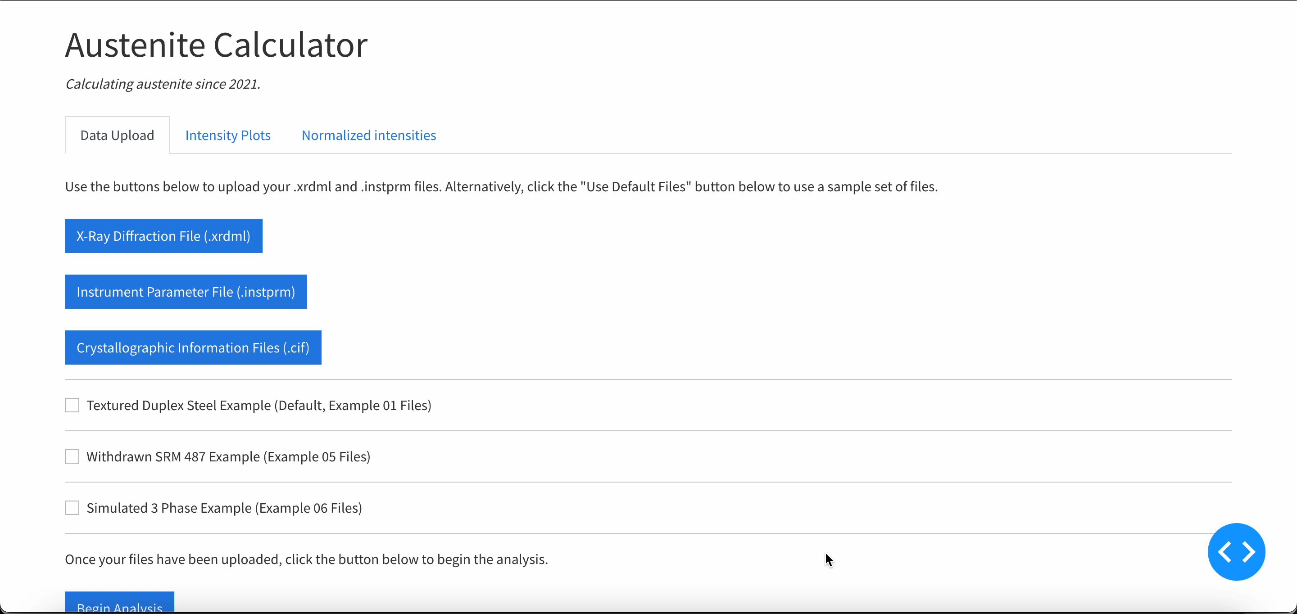
Calculator Demo
Outline of topics to cover:
App orientation (tabs, buttons, etc)
Input tab, How to load a file, prebuilt examples
Data tab, data plot and fit plot. Maybe talk a bit about algorithm we’re using to do the fit?
Results tab, phase fraction table, uncertainties, expanded data, diagnostic plots

Slide 9
Conclusions
Are you interested in use of this application?
What did we forget?
How can it be improved?
Contact Dr. Creuziger or David Newton at NIST for information and to give feedback:
adam.creuziger@nist.gov
david.newton@nist.gov

Slide 11
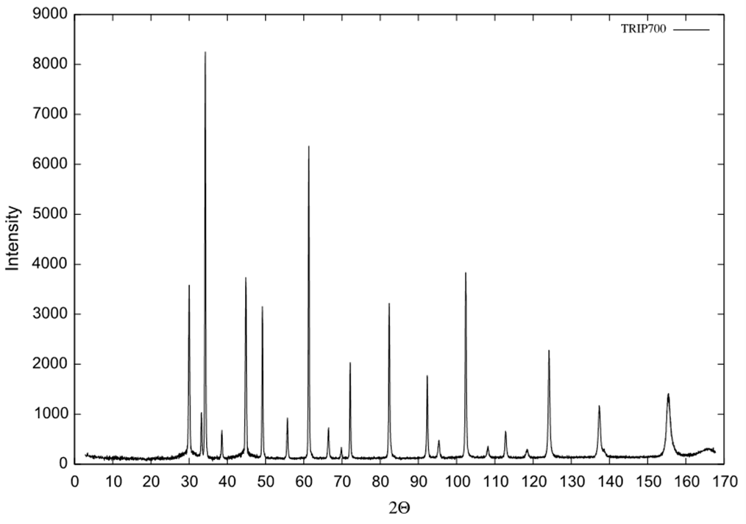
Phase Fraction
What is the calculator doing to determine phase fractions?
Notes:
Using the CIF file, theoretical intensities of each phase as an area under the Int. vs 2theta plot are calculated. The experimental XRD data is plotted, fit, and the area under each peak is found through integration. Fitting will be automated and needs to be highly accurate, currently wrapping development. The area from each experimental peak is normalized by dividing the value by the theoretical value. Each normalized peak for a single phase is summed to get the total normalized area of a single phase. Subsequently, the total normalized area of this phase is divided by the total normalized area from all phases. This results in the fraction of the phase present.

Slide 12

Theoretical Intensity
*need source*
A reference for the integrated area of the pure phases in a microstructure must be developed. See below:
Notes:
Industrial Relevance
Include a clear statement of industrial relevance
Use greater then 20 point Arial font

Slide 13
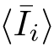
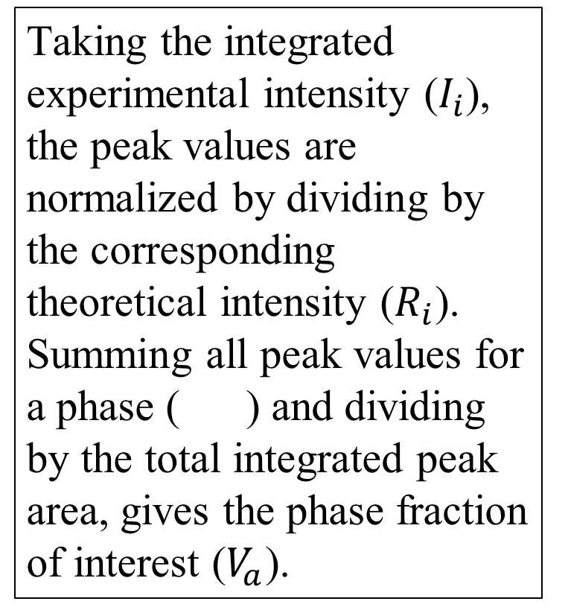
Experimental Phase Fraction
1)
Taking the integrated experimental intensity ($I_{i}$), the peak values are normalized by dividing by the corresponding theoretical intensity ($R_{i}$). Summing all peak values for a phase ( ) and dividing by the total integrated peak area, gives the phase fraction of interest ($V_{a}$).
2)
3)
4)

Slide 14
Modeling
*Add interaction models and dual phase microstructure model*

